Slide 1
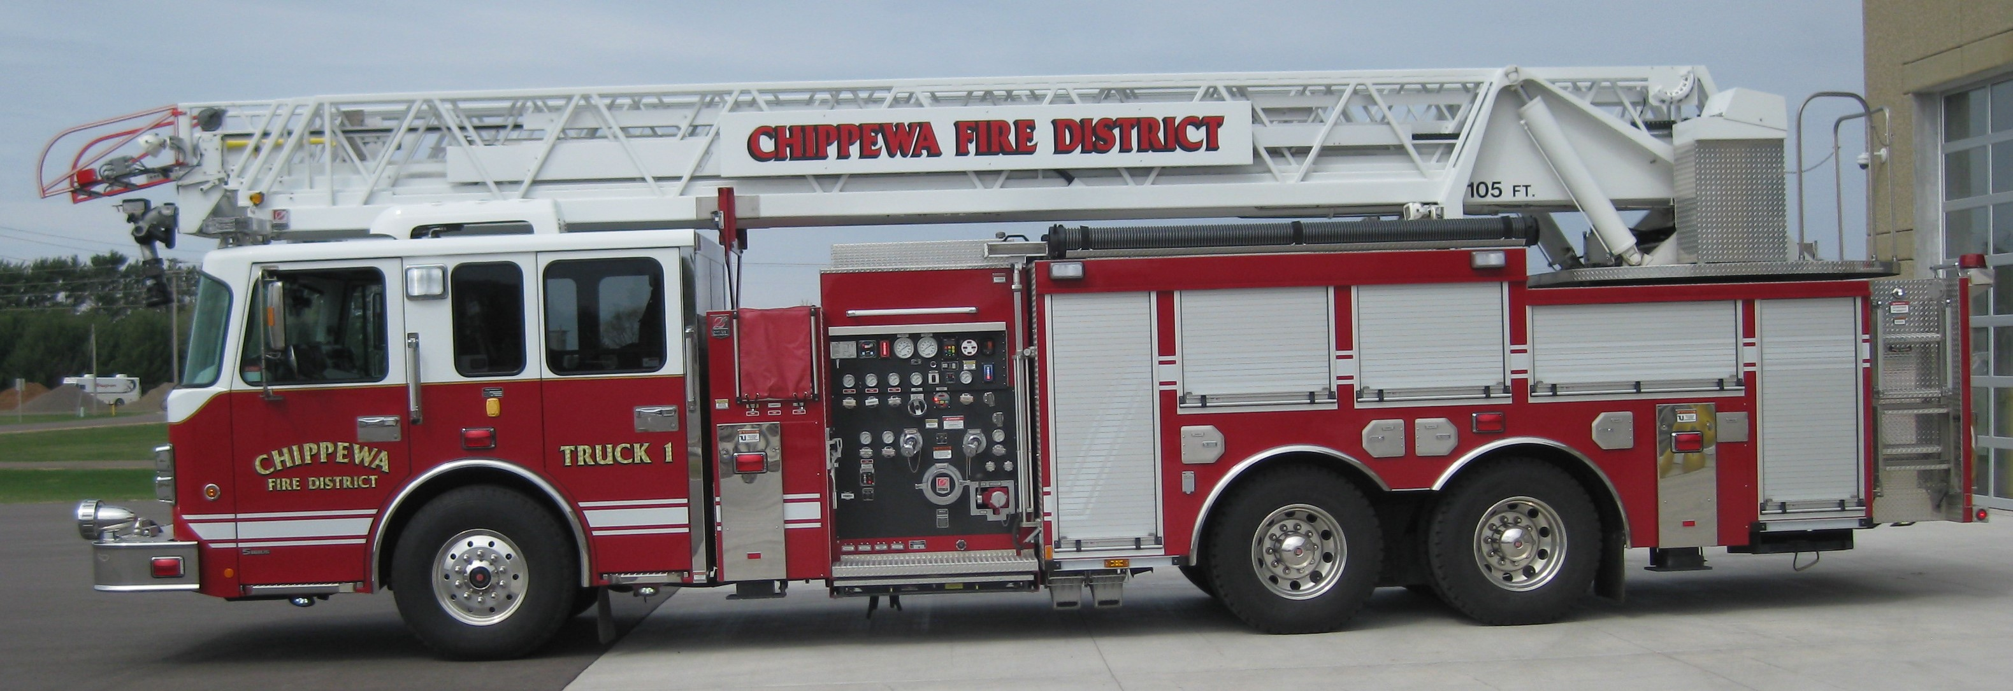
Full-time, Part-time, & Paid on Call Positions
Fire/EMT, Fire only, or EMS openings
Career wages starting at $21.00 - $25.58
Part-time starting at $18.00 to $21.63
Paid-on-call starting at $15.00 to $18.50
Visit www.chippewafiredistrict.com to
apply or call 715-723-5488

